Slide 1
Link Types

Slide 2
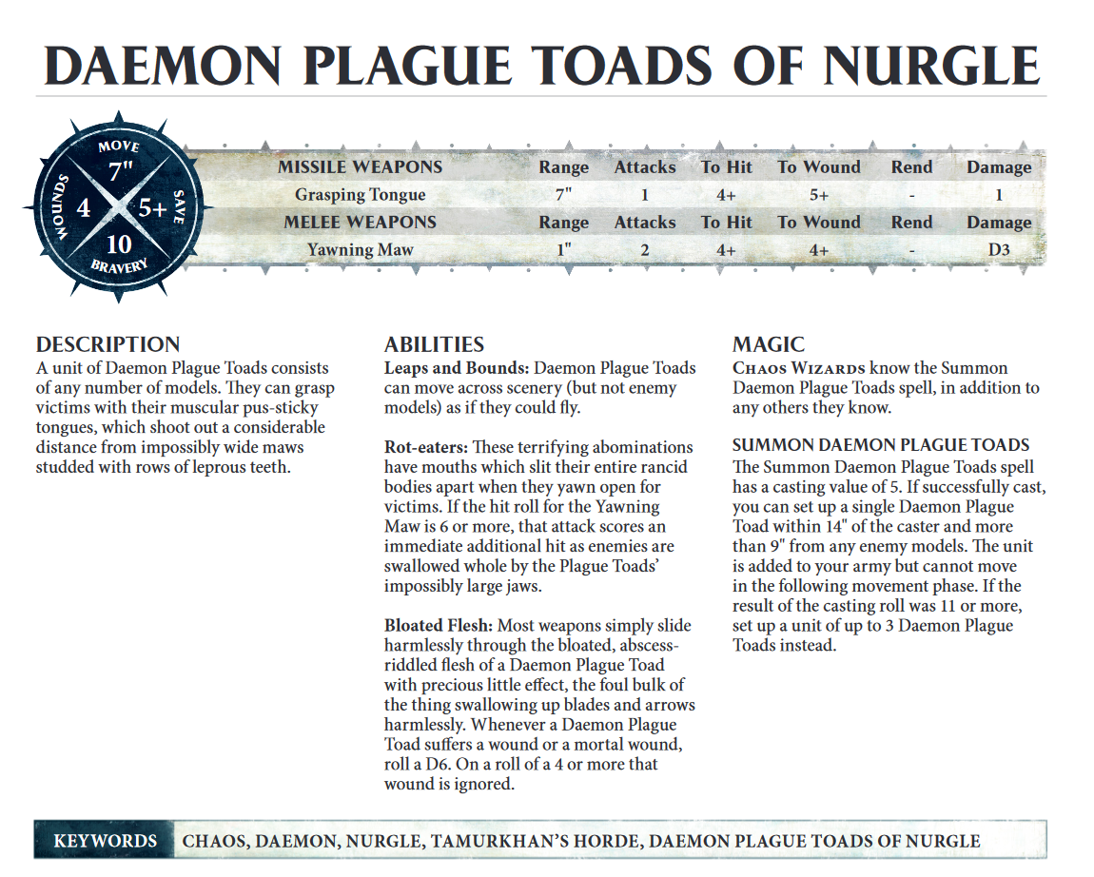
https:\\whc-cdn.games-workshop.com\wp-content\uploads\2017\09\
2017
whc-cdn.games-workshop.com
\wp-content\uploads\2017\09
Only Daemon Plague Toads of Nurgle

Slide 3
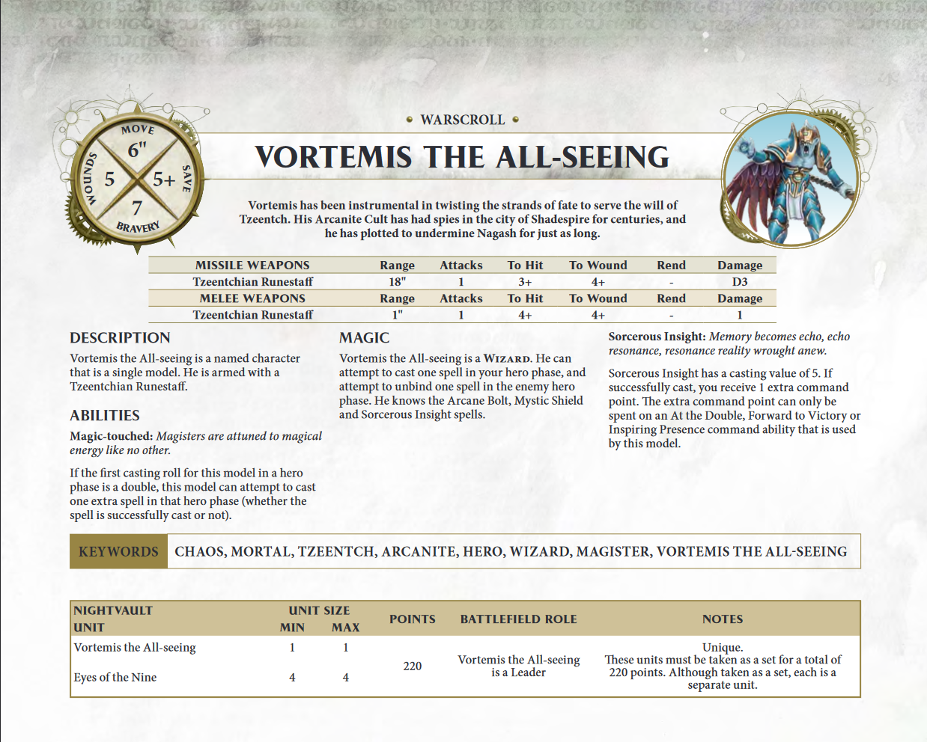
https:\\whc-cdn.games-workshop.com\wp-content\uploads\2018\10\
2018
whc-cdn.games-workshop.com
\wp-content\uploads\2018\10
Only Eyes of the Nine

Slide 4
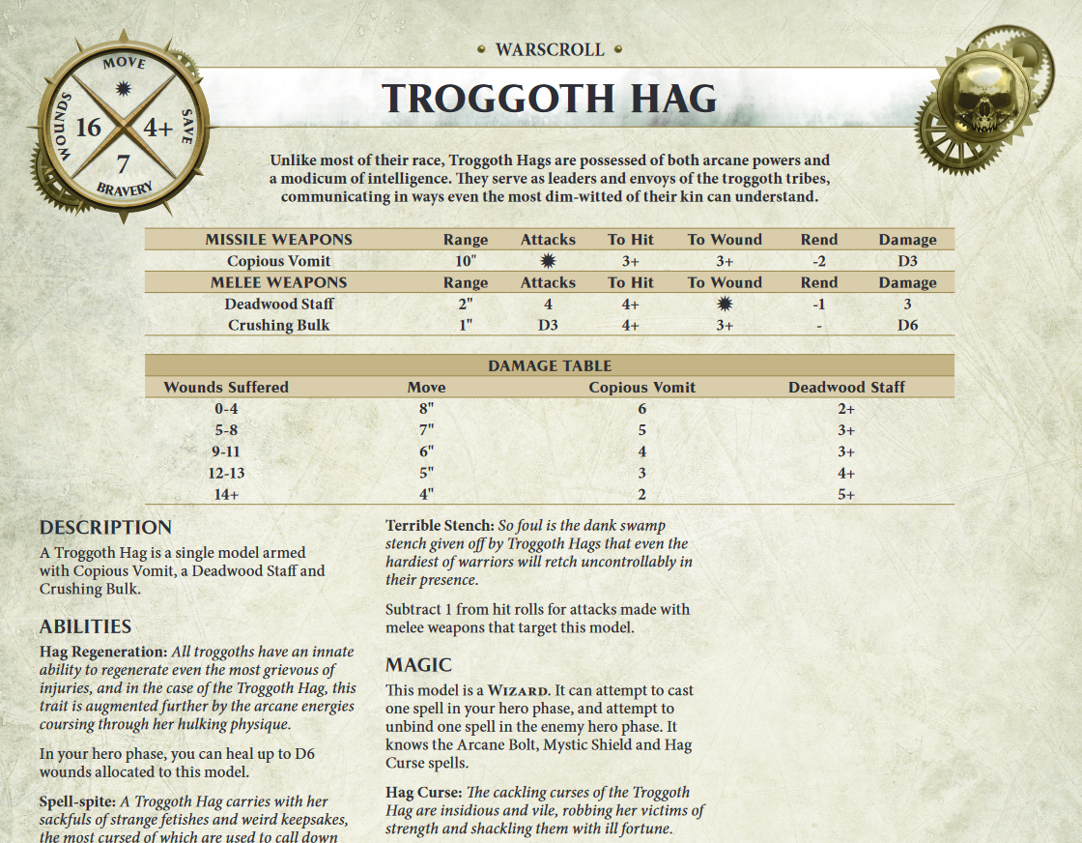
https:\\www.forgeworld.co.uk\resources\fw_site\fw_pdfs\aos_warscrolls\Downloads-AoS\
2019
www.forgeworld.co.uk
\resources\fw_site\fw_pdfs\aos_warscrolls\Downloads-AoS

Slide 5
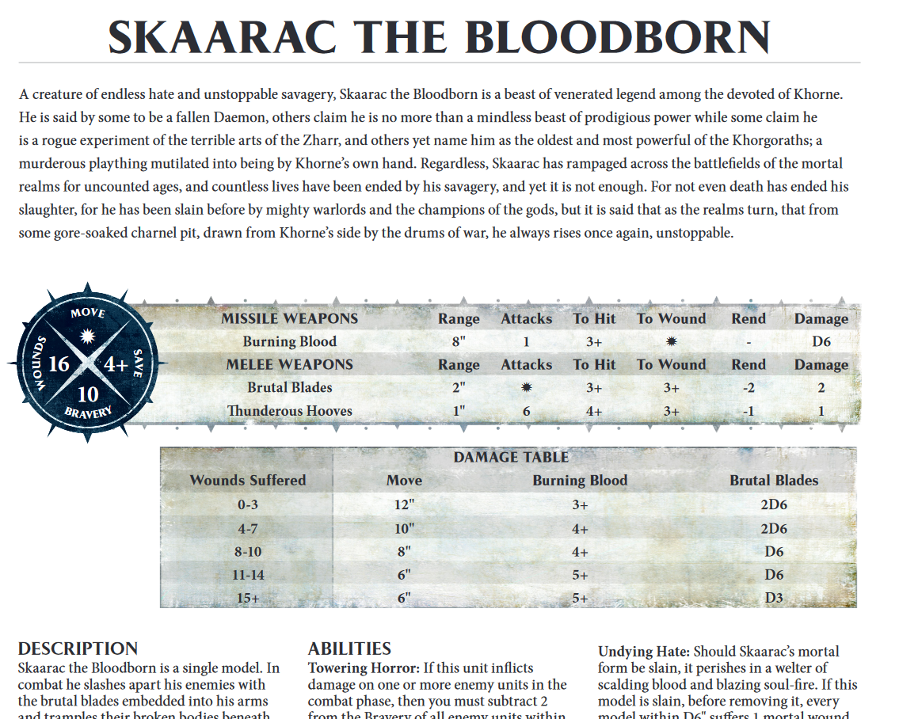
https:\\www.forgeworld.co.uk\resources\fw_site\fw_pdfs\aos_warscrolls\
2016
www.forgeworld.co.uk
\resources\fw_site\fw_pdfs\aos_warscrolls

Slide 6
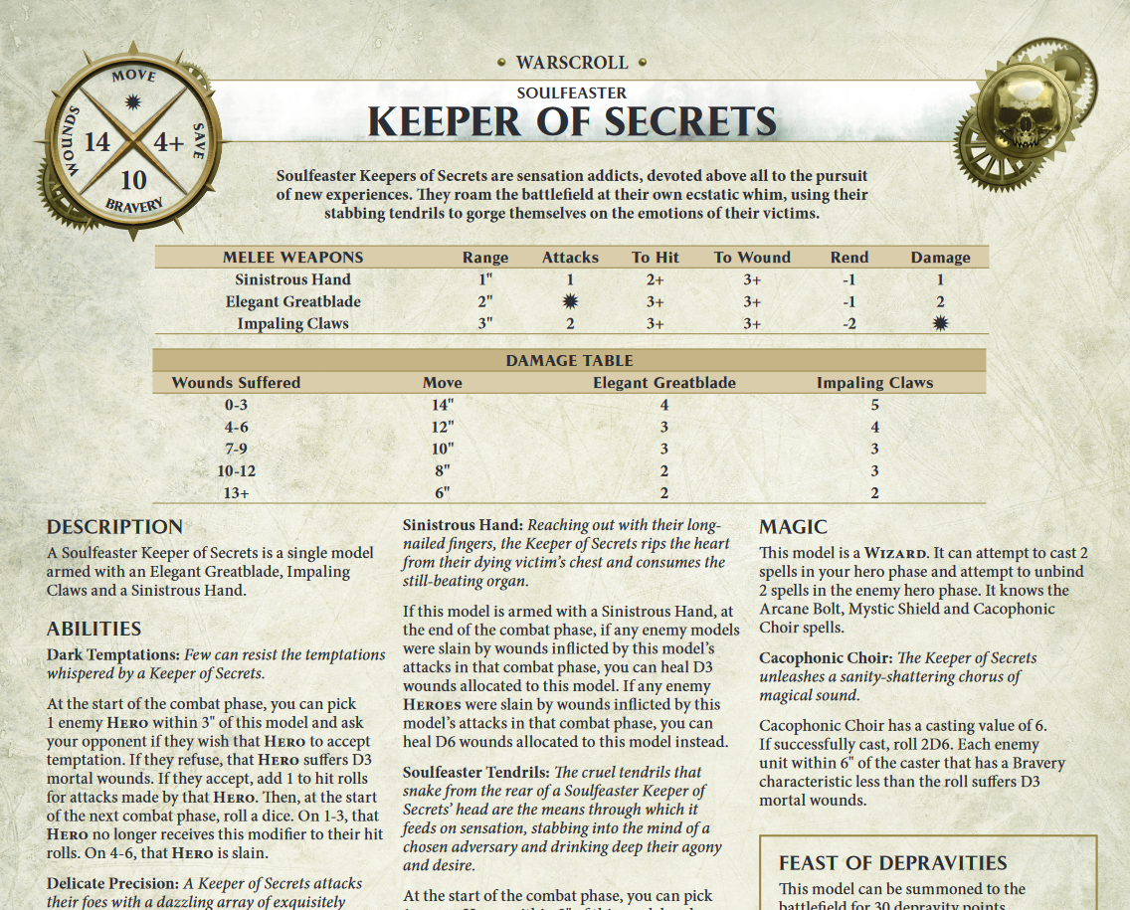
https:\\www.forgeworld.co.uk\resources\PDF\AoS_Warscrolls\\
2019
www.forgeworld.co.uk
\resources\PDF\AoS_Warscrolls
Only Soulfeaster Keeper of Secrets

Slide 7
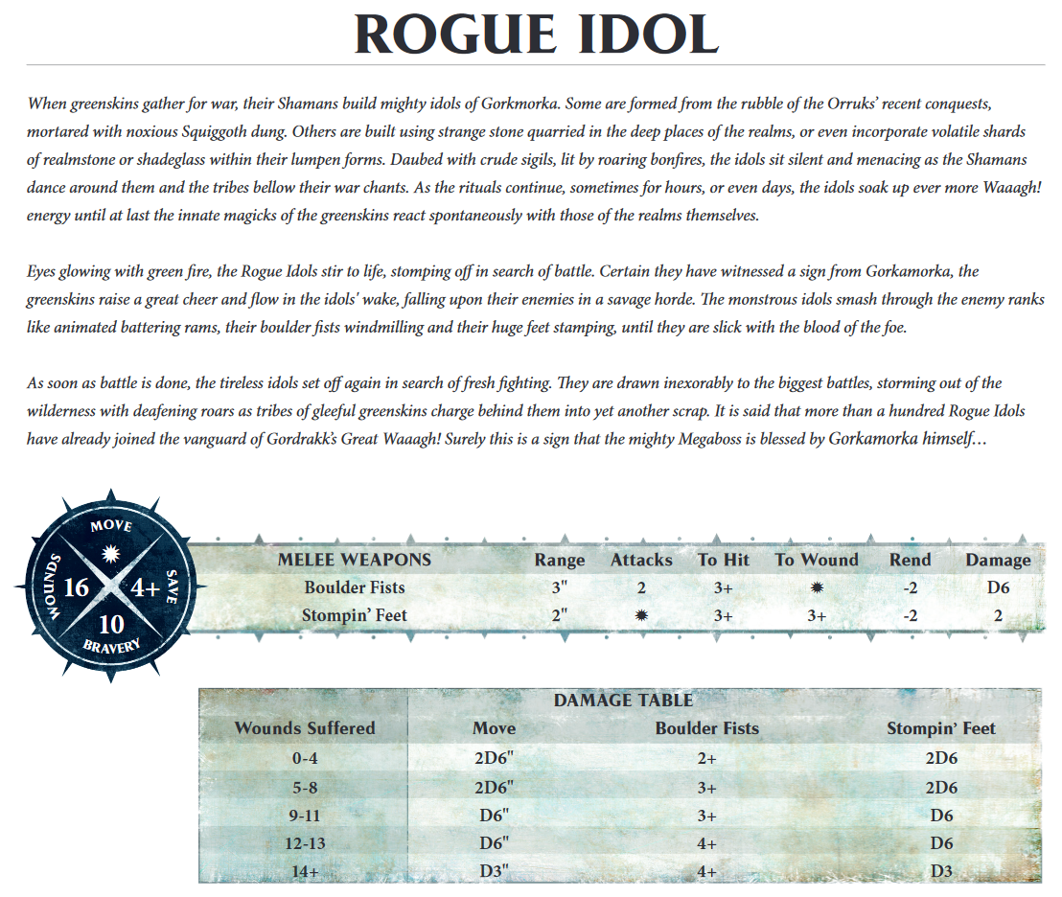
https:\\www.forgeworld.co.uk\resources\PDF\Downloads\
2017
www.forgeworld.co.uk
\resources\PDF\Downloads

Slide 8
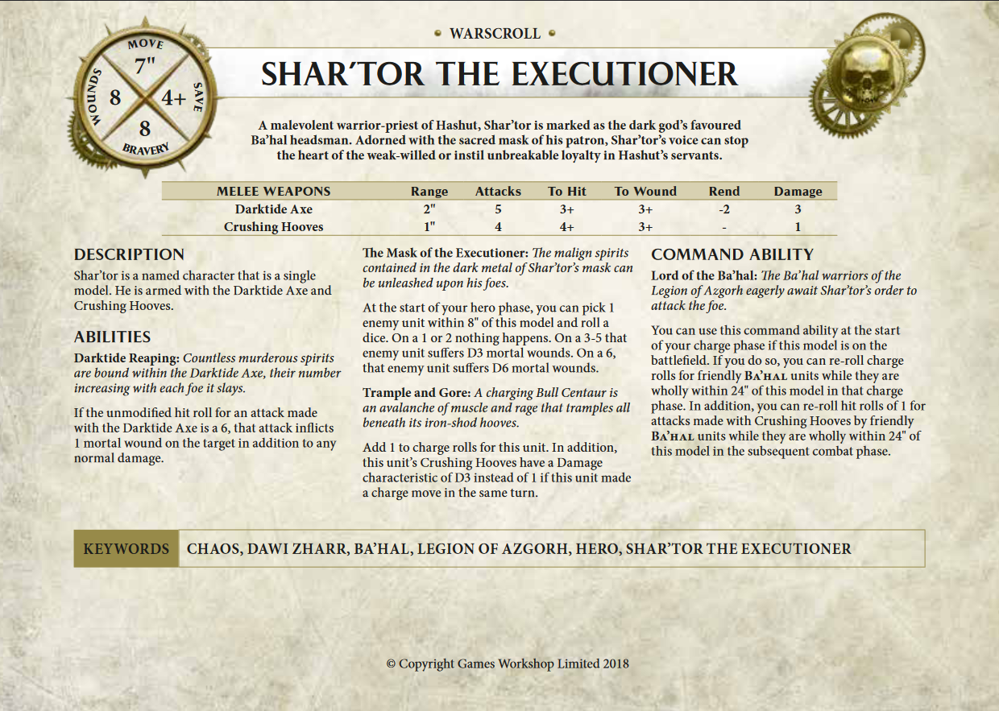
https:\\www.forgeworld.co.uk\resources\PDF\fw_warscrolls\\
2018 \ 2017
www.forgeworld.co.uk
\resources\PDF\fw_warscrolls

Slide 9
https:\\www.games-workshop.com\resources\PDF\AoS_Warscrolls\\

Slide 10
https:\\www.games-workshop.com\resources\PDF\Downloads\\

Slide 11
https:\\www.warhammer-community.com\wp-content\uploads\2018\07\

Slide 12
www.games-workshop.com\resources\PDF\AoS_Warscrolls\

Slide 13
www.games-workshop.com\resources\PDF\Downloads\

